Slide 2
Communications and Education Planning
Highlights of past year
Goals for 2019
Priority topics
District projects and programs
Watershed issues

Slide 3
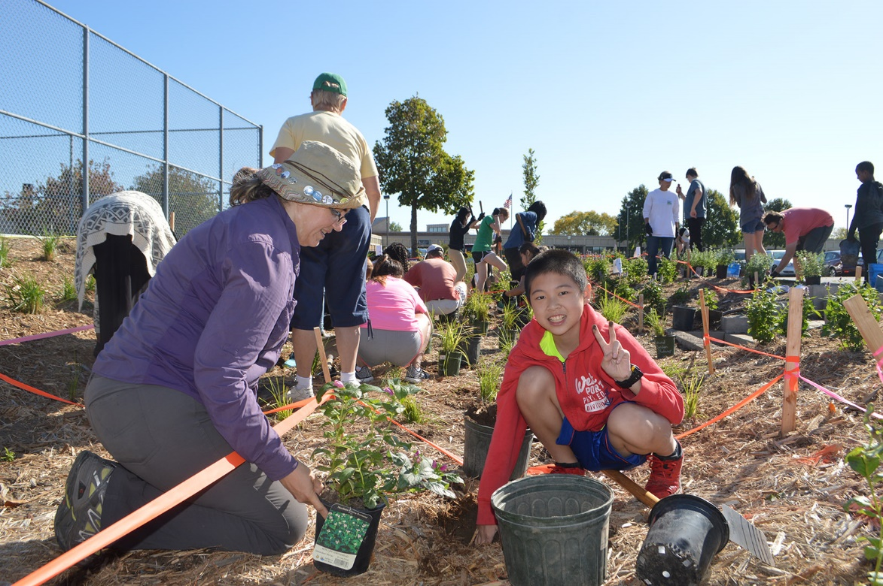
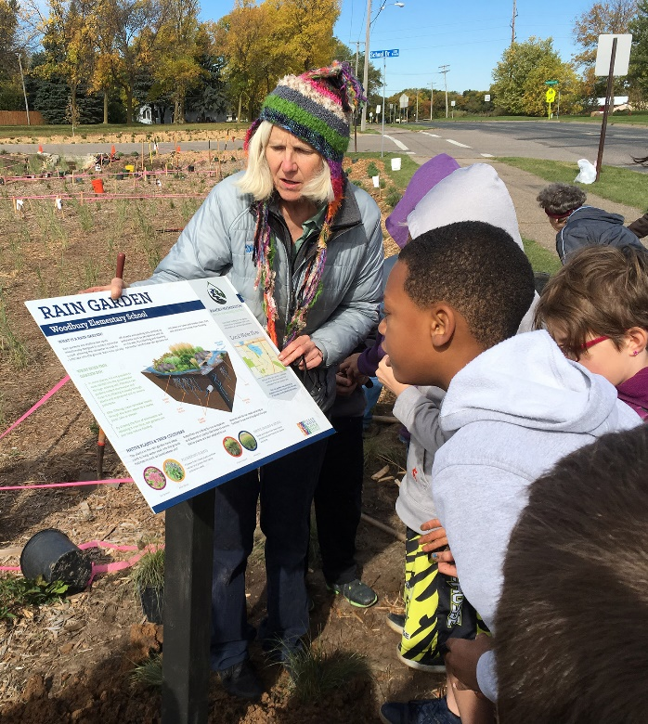
Highlights of past year
Completed Legacy grant-funded raingardens at three schools in Woodbury and Roseville.

Slide 4
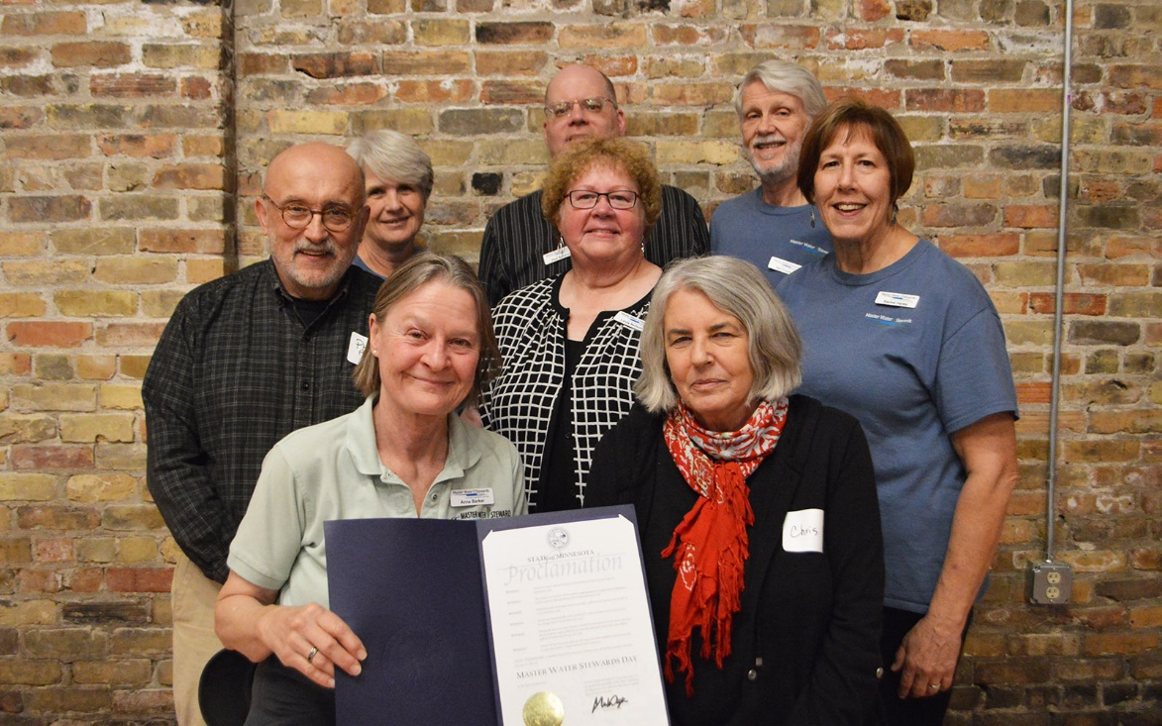
Highlights of past year
Recruited four new Master Water Stewards in 2018. Sixteen are now certified and volunteer in our watershed district.

Slide 5
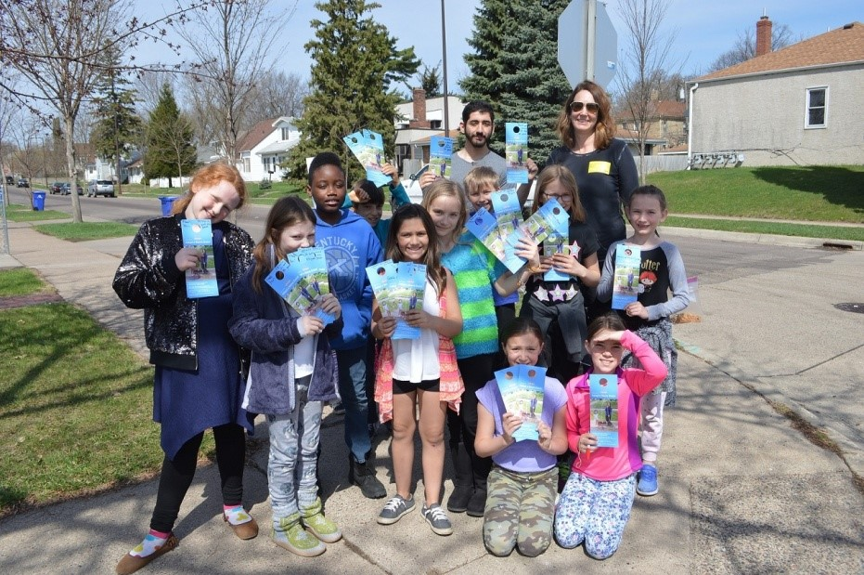
Highlights of past year
Launched Adopt-a-Drain program in Beaver Lake neighborhood.
Additional outreach to increase Lake Phalen area storm drain adoptions.

Slide 6
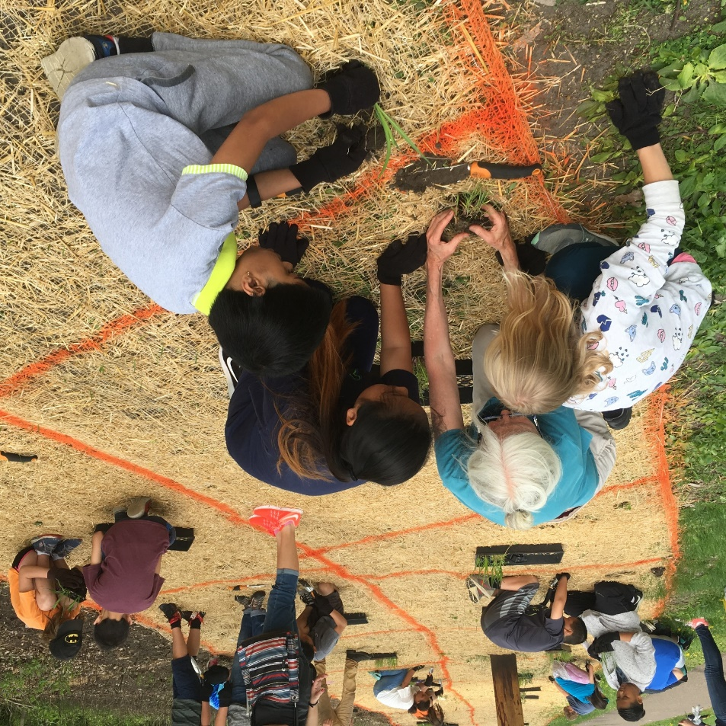
Highlights of past year
Engaged 15 classrooms in planting native buffer along Keller Creek (fourth year).

Slide 7
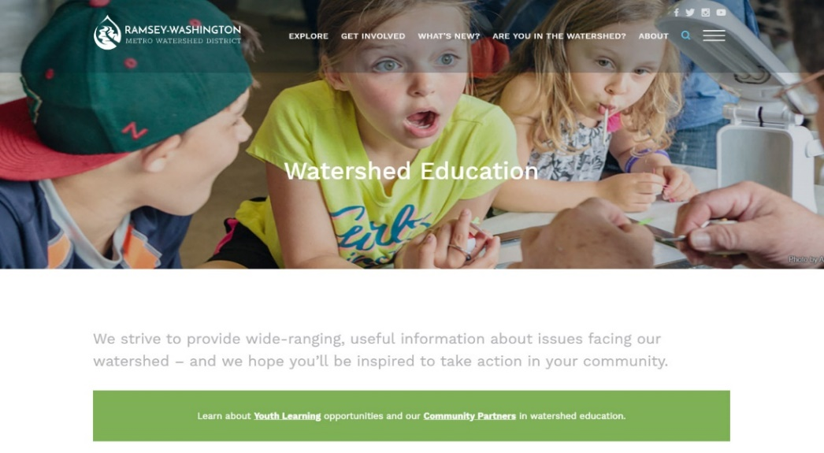
Highlights of past year
Launched new website Feb. 2018
Streamlined site: 133 pages, down from approx. 220
16,425 new users (+7.9 percent) and 30,281 pageviews (+16.6 percent) as of August 27, 2018.
33.2 percent increase in mobile traffic vs. six months prior to launch.
Top pages:
Homepage
WaterFest
Are You in the Watershed?
Our Team
Document Library
Stewardship Grants
Explore/Project Map
Permits
Current Projects
Explore/All Projects

Slide 8
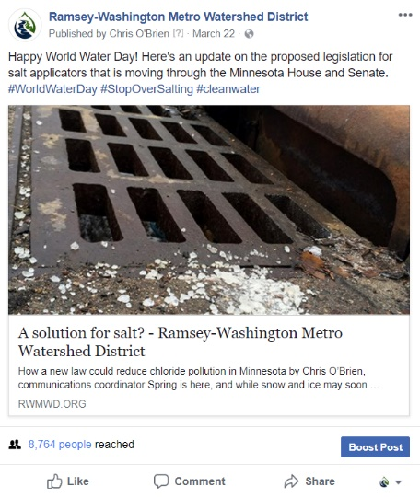
Highlights of past year
Helped raise awareness of chloride pollution
Joined StopOverSalting coalition.
Worked with City of Saint Paul to pass resolution supporting salt application legislation.
Met with House Natural Resources Finance and Policy Chair to discuss legislation.
Delivered letter of support to 10 legislators.
Legislative update blog article received 8,700+ views on Facebook.

Slide 9
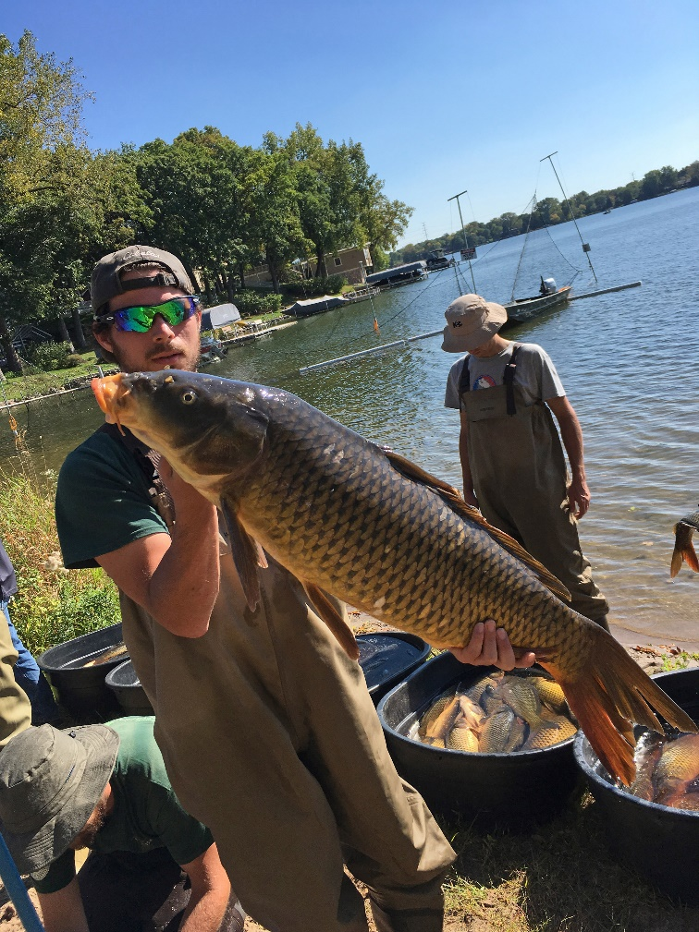
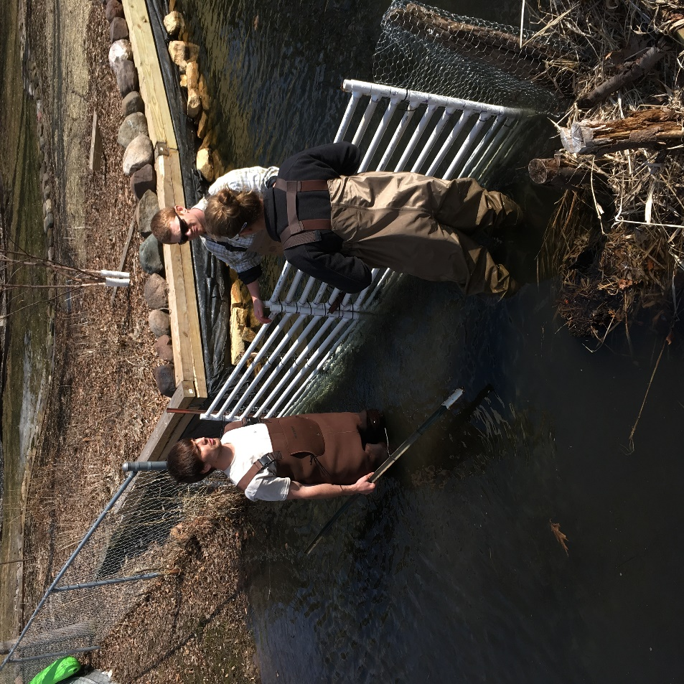
Highlights of past year
Outreach on carp management
Successfully pitched Star Tribune article on carp management.
Numerous blog and social media posts, including video of carp barrier and electroshocking.

Slide 11
Goals for 2019
Integrate communications and education efforts into priority topics and projects.
Partner with key stakeholders to educate public:
City and county staff
Elected officials and district councils
Schools
Churches
Work with community leaders and organizational partners to reach new audiences.

Slide 12
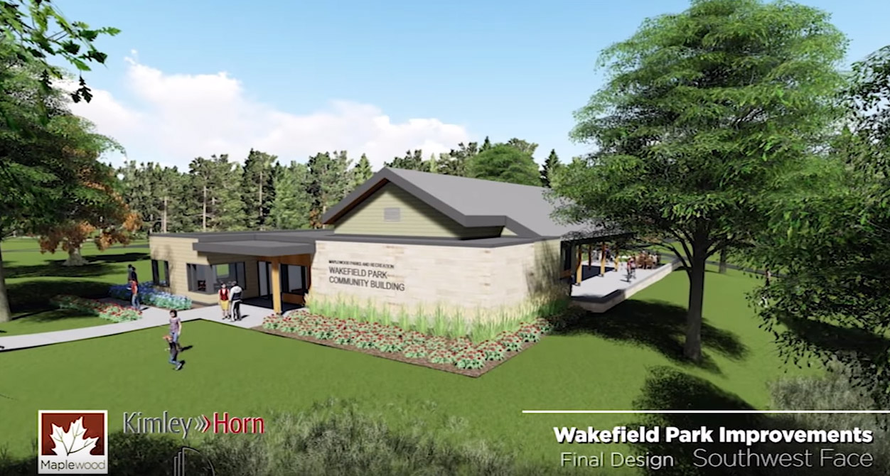
Priority topics
District projects and programs
Wakefield Park renovation
Strategy: Partner with City of Maplewood on future celebration events and video coverage.

Slide 13
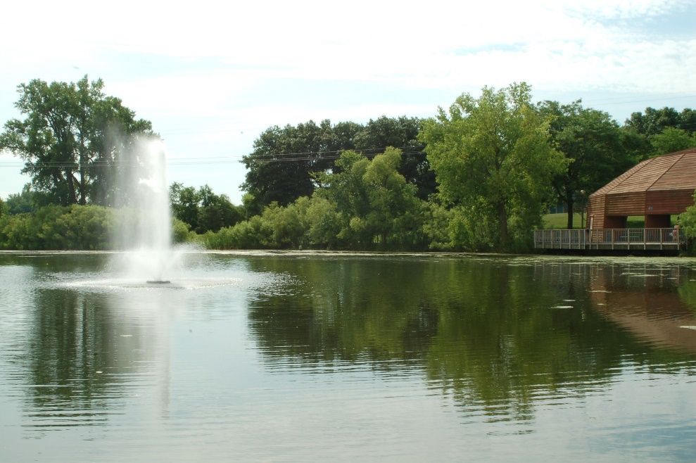
Priority topics
District projects and programs
Bennett Lake improvements (Willow Pond and Roseville High)
Strategy: Empower neighborhood leaders to educate community about water quality challenges and potential for improvement.

Slide 14
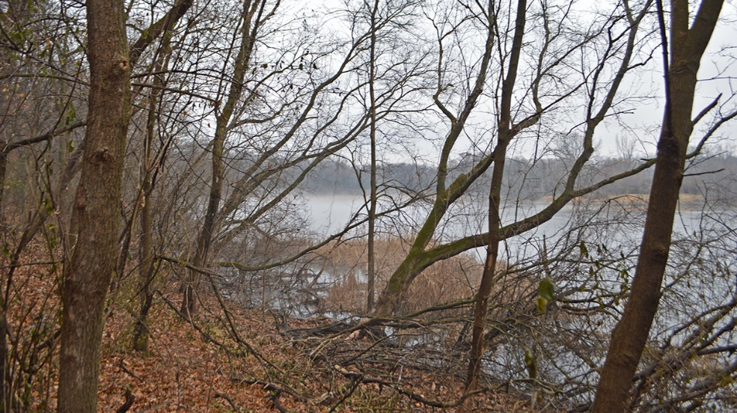
Priority topics
District projects and programs
Grass Lake and Snail Lake drainage optimization
Strategies:
Provide periodic updates to local press and email list.
Coordinate with cities and Ramsey County to share progress.
Vadnais-Snail Lake Park habitat restoration
Strategies:
Provide on-site signage and web page during restoration.
Involve 12-15 classes, park users and local Wild Ones chapter in restoration/planting.

Slide 15
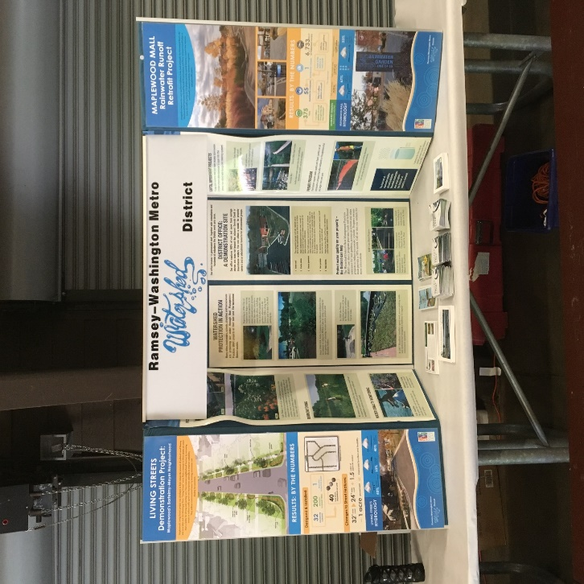
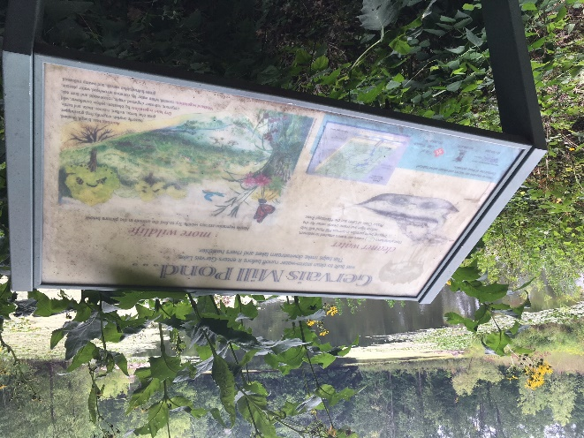
Priority topics
District project and programs
Signage needs (create or update)
District table-top display (update)
Stand-up banner (create)
Willow Pond spent lime filter sign (create)
Gervais Mill Pond interpretive signs (update)
District office (update main building sign and interpretive signage)
Keller Creek portage

Slide 16
Priority topics
District projects and programs
WaterFest – 20th Anniversary
Strategies
Create updated logo, retrospective video with past photos, and organize special performance or program.
Partner with Friends of the Mississippi River and the City of St. Paul in storm drain mural project at Phalen Park.
Phalen Chain Water Trail Strategies
Produce video highlighting water trail and points of interest.
Consider on-site water trail signage.

Slide 17
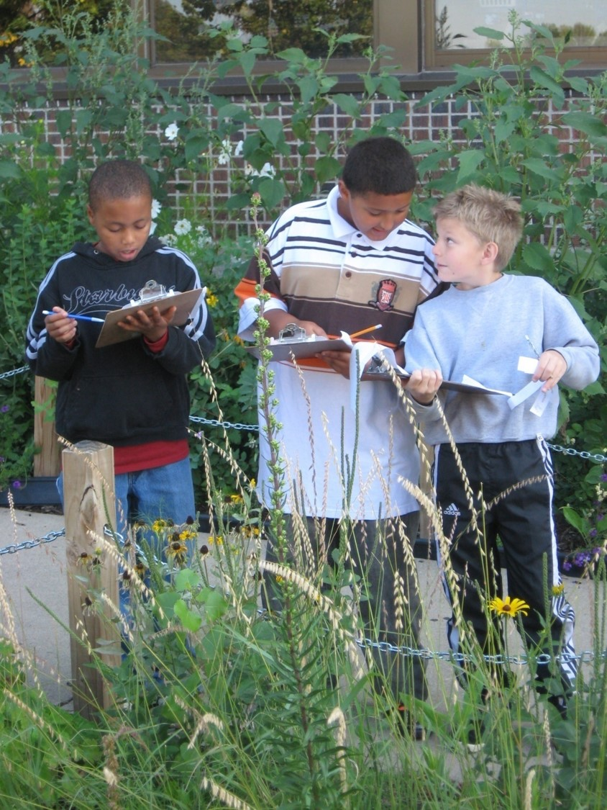
Priority topics
District project and programs
School engagement
Provide hands-on watershed lessons for current 13 partner schools.
Extend outreach to these new schools:
Highwood Hills Elementary (St. Paul)
Island Lake Elementary (Shoreview)
Oak Hill Montessori (Shoreview)
North Heights Christian Academy (Roseville)
Heights Community School (St. Paul)
St. John School (Little Canada)

Slide 18
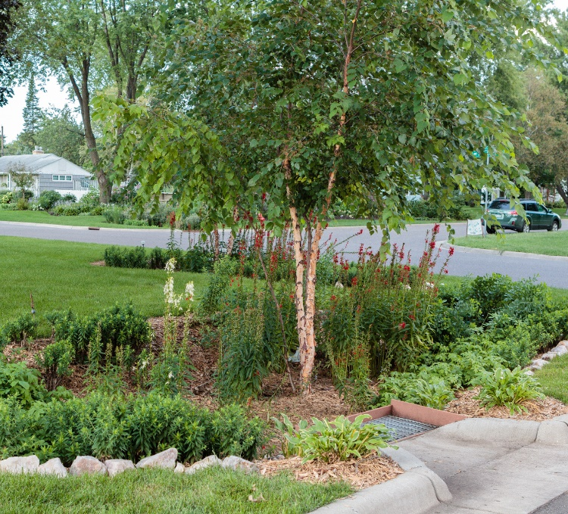
Priority topics
District projects and programs
Stewardship Grants Program
Strategies:
Develop relationships with community groups to reach diverse communities.
Kitty Anderson Youth Science Center
East Side Area Business Association
Community Stabilization Project
Create new printed piece with photo examples and how to apply.
Highlight targeted shoreline project with Snail Lake residents.
Collaborate with Boys and Girls Club on outreach during parking lot project.

Slide 19
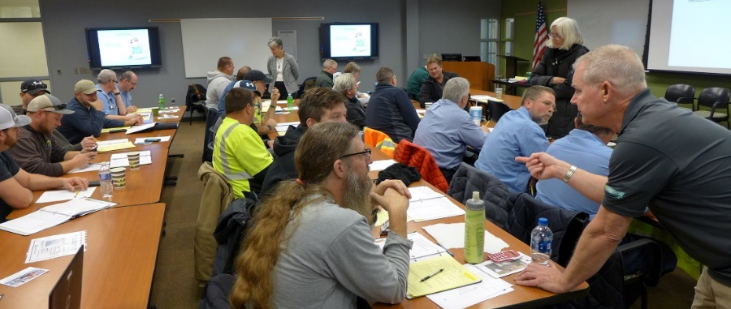
Priority topics
Watershed issues
Climate change and resiliency planning
Strategy: Engage city staff in local planning workshops.
Chloride awareness and training
Strategies:
Organize Smart Salting workshops; recruit public and private participants.
Track legislative efforts; work with MAWD, Freshwater and other partners.

Slide 20
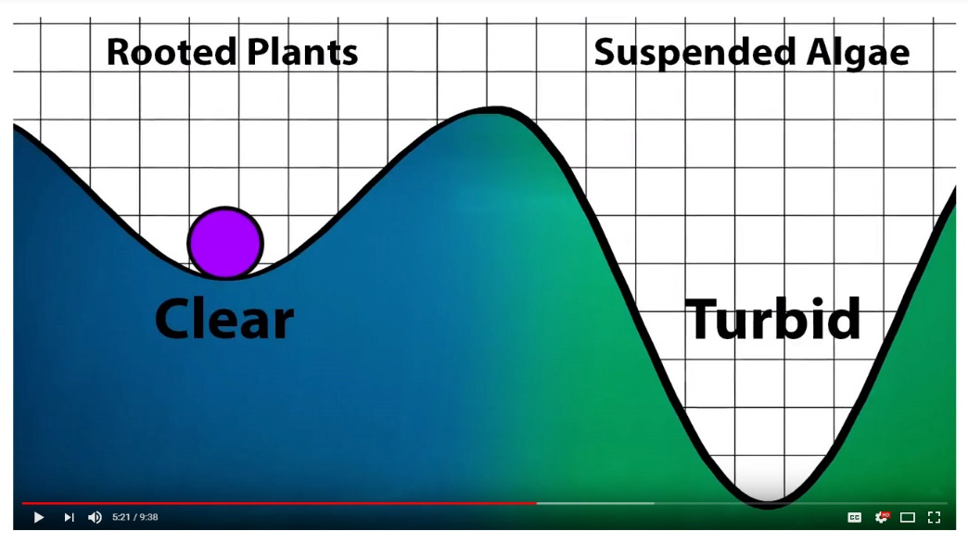
Priority topics
Watershed issues
Shallow lakes management
Strategies:
Promote “Getting to Know Shallow Lakes” video using input from Citizen Advisory Committee.
Share with nature centers, state agencies, District councils and local officials.
Show video at MAWD conference.

Slide 21
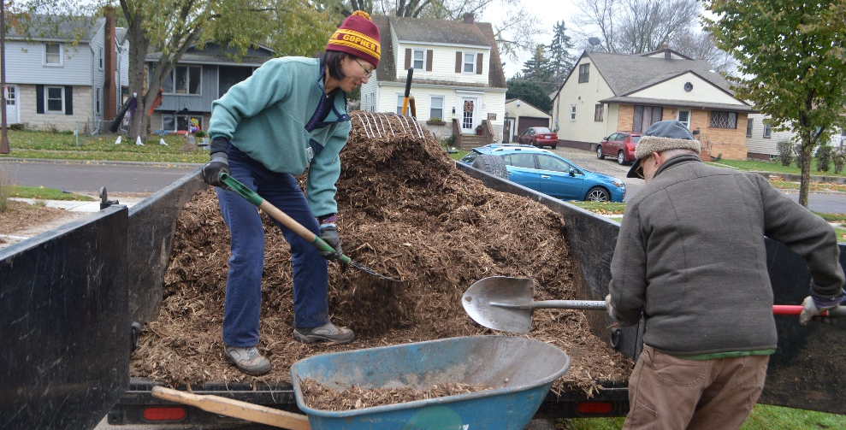
Priority topics
Watershed issues
Native planting, rain gardens and turf alternatives
Strategies:
Partner with Blue Thumb on workshops for alternative turf and bee lawns.
Engage Lions Gate School (Shoreview) in their new rain garden and alternative turf project.
Work with Master Water Stewards and Master Gardeners to support projects and outreach in their communities.

Slide 22
Priority topics
Watershed issues
Stormwater pollution
Strategies:
Engage churches in adopting storm drains adjacent to their property.
Evaluate whether to add a new neighborhood for Adopt-a-Drain program in 2019.
Organize and support Adopt-a-Drain neighborhood clean-ups with L’Etoile du Nord, Farnsworth, Central Park Elementary students and others.

